Slide 1
Alta Performance com Java
Java OO com Alta Performance

Slide 2
Apresentação
Atuo na área de TI desde 1996 e com Java e aplicações corporativas desde 2004. Tive a oportunidade de participar de grandes projetos para clientes como: HP, EDS, Bosch, Mitsubhishi e para os Governos de Santa Catarina, São Paulo e Mato Grosso do Sul. Atualmente me encontro imerso na cultura Ágil e palestrando em importantes eventos como Javaneiros e Flisol.
@apedrina
pedrina.alisson@gmail.com
www.alissonpedrina.wordpress.com

Slide 3
O curso
Como nasceu a ideia
Como evoluiu
Para onde vai

Slide 4
Conteúdo
A tecnologia Java - O que é? - História - Presente - Futuro - Mercado de Trabalho
Performance - O que é? - Quando Testar - O que testar - Ferramentas - Como testar
Arquitetura da JVM
O Modelo de Memória
Web
Agilidade
Clean Code
Entrega Contínua

Slide 5
Conteúdo
A tecnologia Java - O que é? - História - Presente - Futuro - Mercado de Trabalho
Performance
Arquitetura da JVM
O Modelo de Memória
Web
Agilidade
Clean Code
Entrega Contínua

Slide 6
The Java Technology

Slide 7

What is?
Language
Plataform
JVM

Slide 8
History of Java Technology
http://www.javatpoint.com/history-of-java

Slide 9
Green Team
James Gosling, Mike Sheridan, and Patrick Naughton initiated the Java language project in June 1991. The small team of sun engineers called Green Team.
Originally designed for small, embedded systems in electronic appliances like set-top boxes.
Firstly, it was called "Greentalk" by James Gosling and file extension was .gt.
After that, it was called Oak and was developed as a part of the Green project.

Slide 10
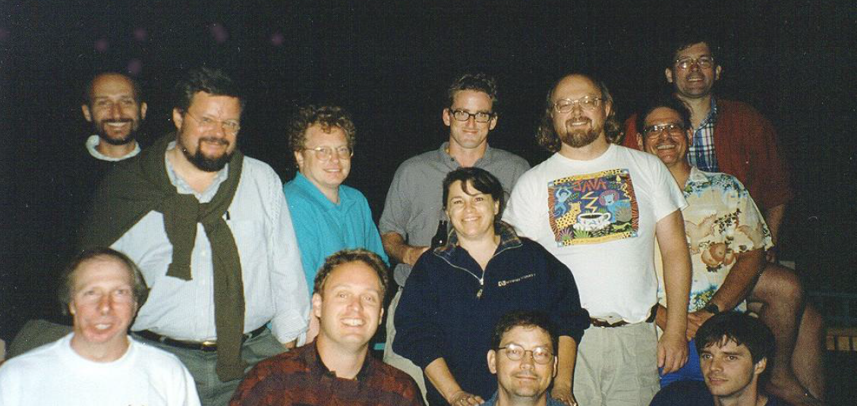
Green Team

Slide 11
Why OAK?
Oak is a symbol of strength and choosen as a national tree of many countries like U.S.A., France, Germany, Romania etc.
In 1995, Oak was renamed as "Java" because it was already a trademark by Oak Technologies.

Slide 12
Why Java?
The team gathered to choose a new name. The suggested words were "dynamic", "revolutionary", "Silk", "jolt", "DNA" etc. They wanted something that reflected the essence of the technology: revolutionary, dynamic, lively, cool, unique, and easy to spell and fun to say.
According to James Gosling "Java was one of the top choices along with Silk". Since java was so unique, most of the team members preferred java.
Java is an island of Indonesia where first coffee was produced (called java coffee).
Originally developed by James Gosling at Sun Microsystems (which is now a subsidiary of Oracle Corporation) and released in 1995.

Slide 13
Versions
JDK Alpha and Beta (1995)
JDK 1.0 (January 23, 1996) | Oak
JDK 1.1 (February 19, 1997)
J2SE 1.2 (December 8, 1998) | Playground
J2SE 1.3 (May 8, 2000) | Kestrel (hotspot)
J2SE 1.4 (February 6, 2002) | Merlin (jcp) jsr59
J2SE 5.0 (September 30, 2004) | Tiger
Java SE 6 (December 11, 2006) | Mustang
Oracle 2010
Java SE 7 (July 28, 2011) | Dolphin
Java SE 8 (March 18, 2014)

Slide 14
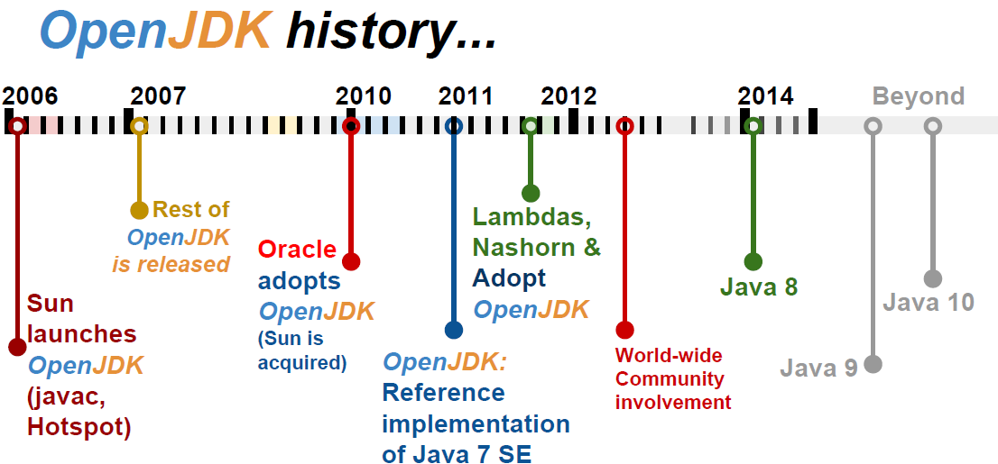
To promote and support community involvement in the development, adoption and evangelism of OpenJDK projects

Slide 15
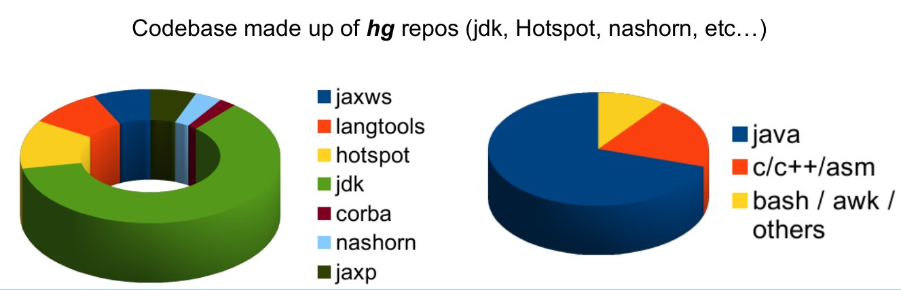
Codebase OpenJdk

Slide 16
Nowadays
Java now !!!

Slide 17
JCP and JSR
Welcome to jcp.org, home of the Java Community ProcessSM (JCPSM) Program. The JCP is the mechanism for developing standard technical specifications for Java technology. Anyone can register for the site and participate in reviewing and providing feedback for the Java Specification Requests (JSRs), and anyone can sign up to become a JCP Member and then participate on the Expert Group of a JSR or even submit their own JSR Proposals.

Slide 18
JDK Enhancement Proposal
The JDK Enhancement Proposal (or JEP) is a process drafted by Oracle Corporation for collecting proposals for enhancements to the Java Development Kit and OpenDK.

Slide 19
Meta-circular and dynamics languages
Maxine - JVM
Graal VM – compilador e interpretador
Jruby
Jython
Nashorn
Scala
Groovy

Slide 20
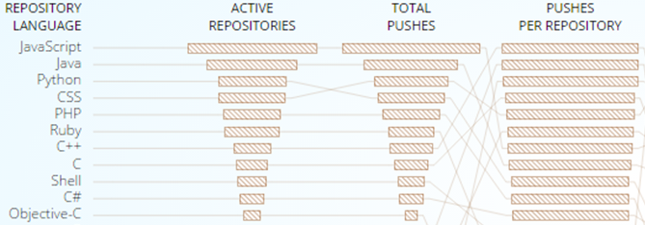
GitHub

Slide 21
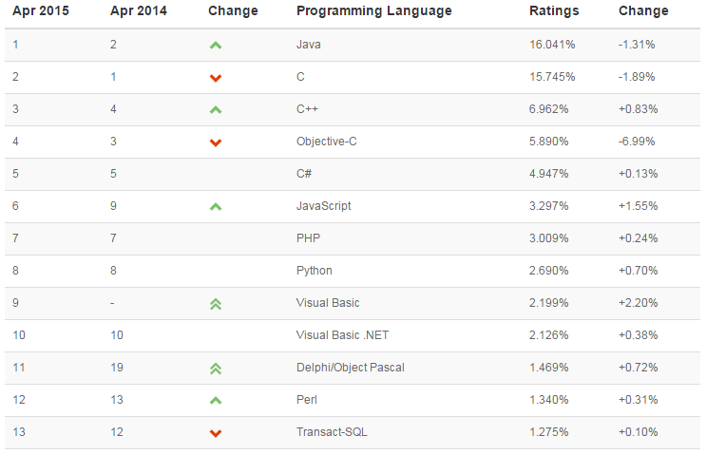
TIOB TIOBE checks more than 300 million lines of software code for its customers world-wide, real-time, each day.

Slide 22
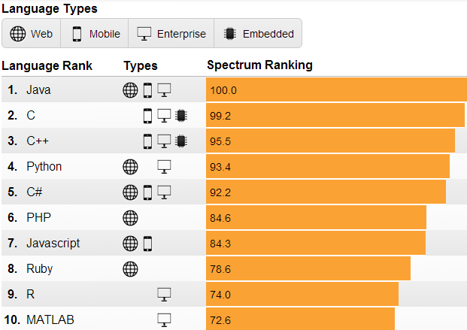
IEEE is the world's largest professional association dedicated to advancing technological innovation and excellence for the benefit of humanity.

Slide 23
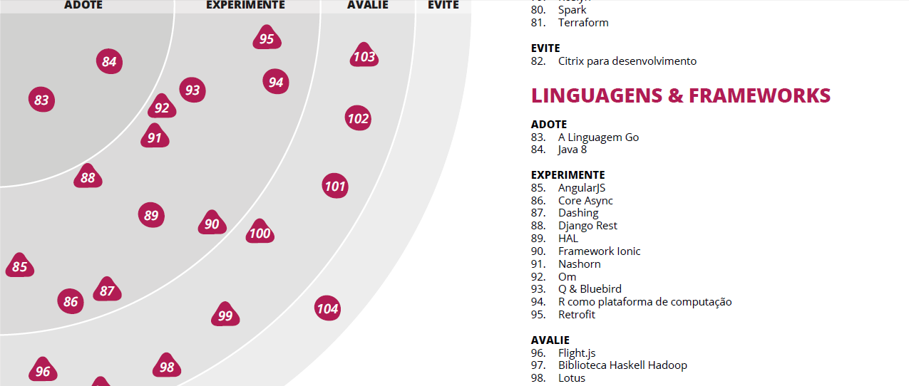
Radar thoughtworks

Slide 24
Job market
In Brasil and in the world

Slide 25
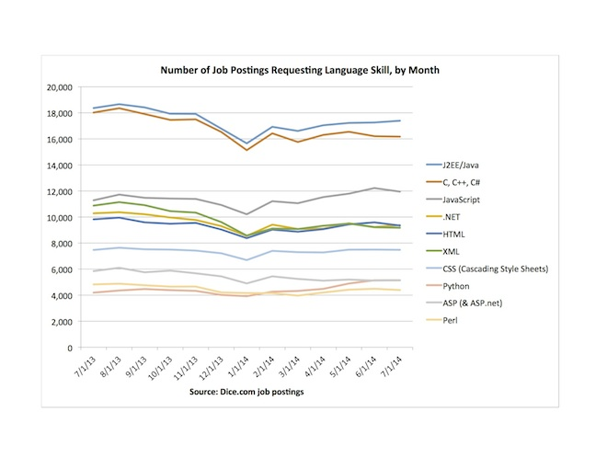
Dice.com

Slide 26
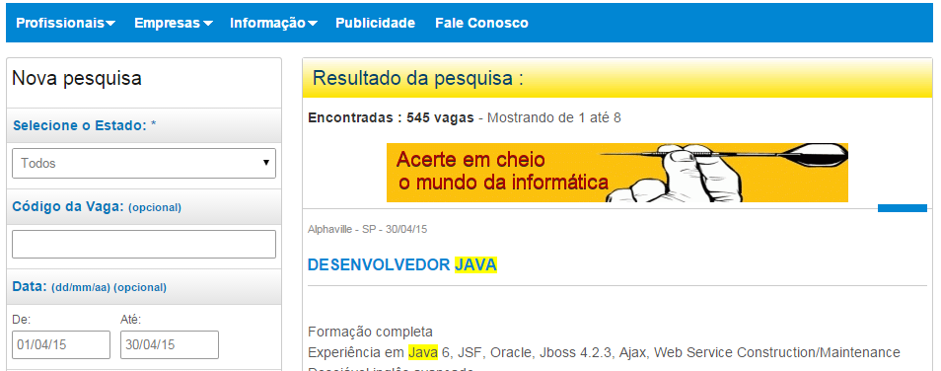
www.apinfo.com

Slide 27












Some companies

Slide 28
How to surf current wave

Slide 29
This makes the differences
Solid principles OO
Design Patterns
S.O.L.I.D
Clean code
Automated Testing
TDD
Agile manifesto

Slide 30
Performance

Slide 31

What is?
Performance scalability bottleneck

Slide 32



When testing?
Early
Afternoon
Balanced

Slide 33
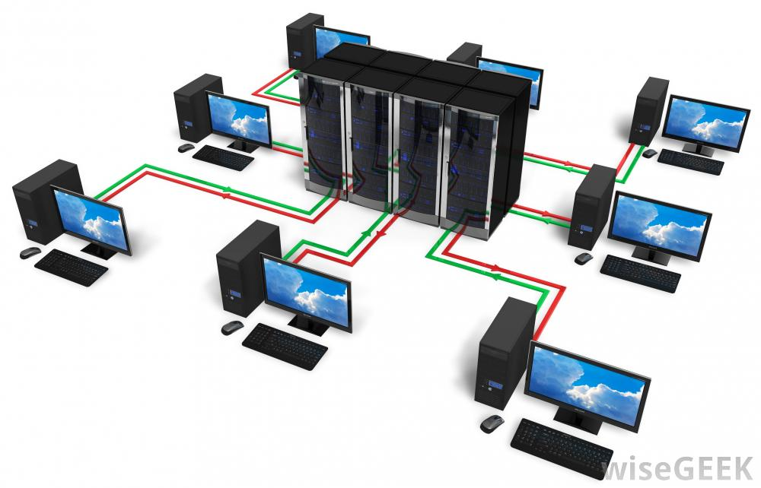
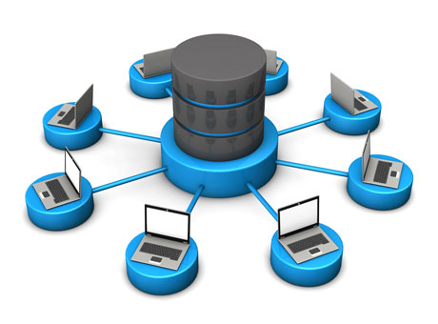
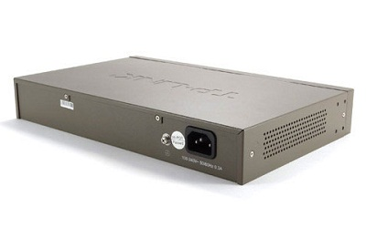
Where is bottleneck?

Slide 34
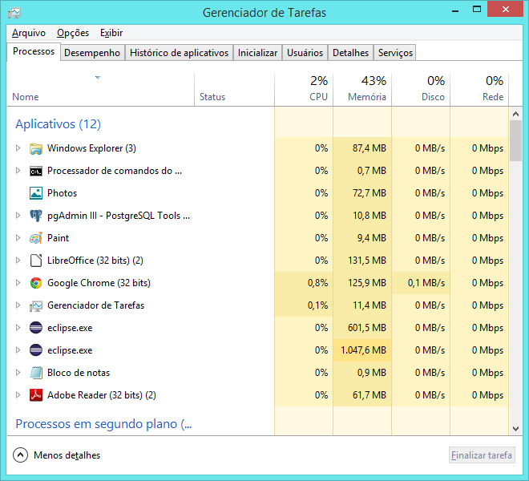
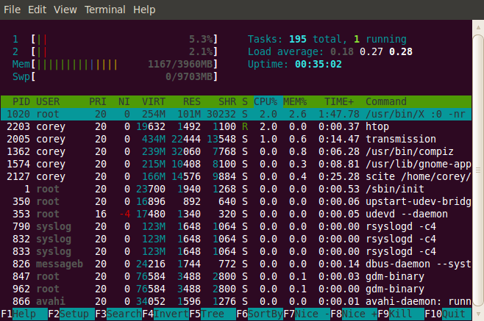
Tools

Slide 35
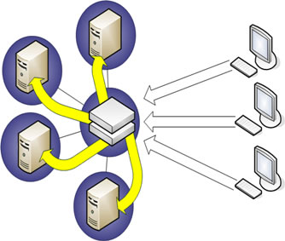
Tests
Real applications
Exact copy
Subsystems
Regression testing

Slide 36

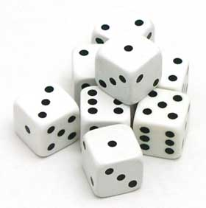
Which helps
Queuing theory
Probability

Slide 37
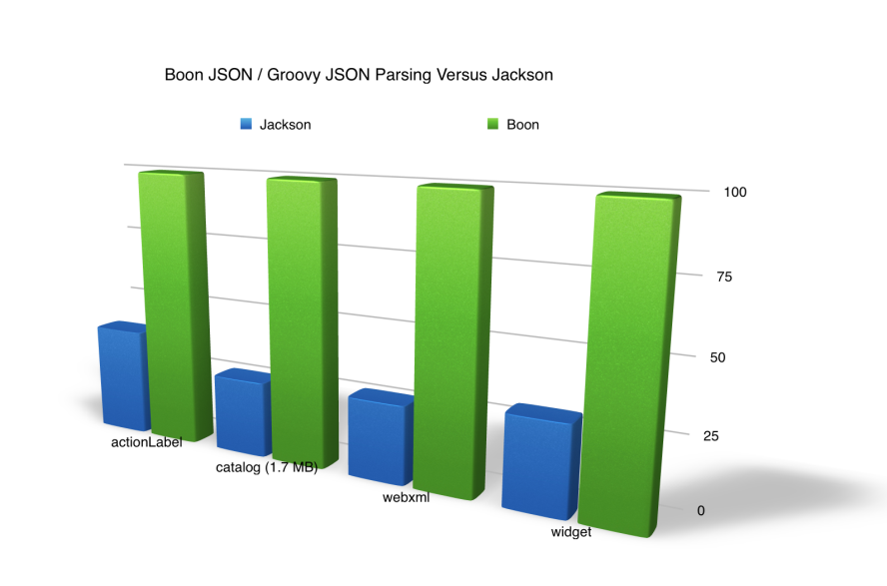
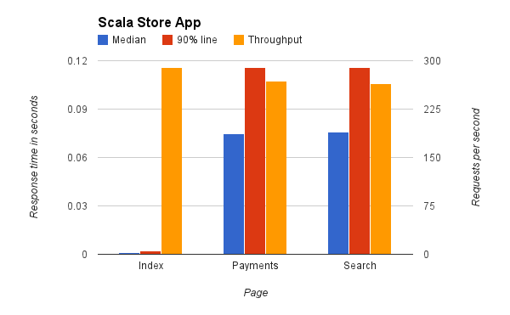
Benchmark
Microbenchmark
Macrobenchmark
Mesobenchmark

Slide 38
Which mesuare
Response Time
Batching
Latency
Throughput
Scalability
Stress Testing

Slide 39
Stress Testing
if you find yourself running tests for more than 24 hours you are doing a stress test.

Slide 40
Scalability
is the measure of how your system responds when additional hardware is added.

Slide 41
Throughput
transactions per second your application can handle (motivation / result of load testing). A typical enterprise application will have lots of users performing lots of different transactions. You should ensure that your application meets the required capacity of enterprise before it hits production.
Throughput
OPS/TPS /RPS and average time
Ex: 500ops at 0.5s x 400ops at 0.4s

Slide 42
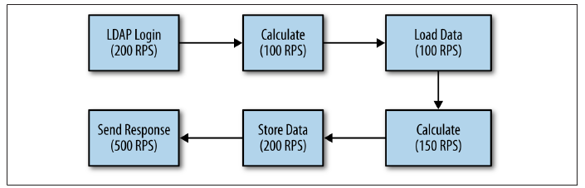
What is that?

Slide 43
Response Time
Amount of time system takes to process a request after it has received one. For instance you have API and you want to find how much time that API takes to execute once invoked, you are in fact measuring response time.
Think time
Média tempos somados dividido pelo número de request
Porcentagem 90%, 5%, etc

Slide 44
Latency
In simplest terms this is Remote Response time. For instance, you want to invoke a web service or access a web page. Apart from the processing time that is needed on the server to process your request, there is a delay involved for your request to reach to server. While referring to Latency, it’s that delay we are talking about.
Networking virtualization

Slide 45
Tips
Variability
Probability
Do not sacrifice solide principles of architecture in exchange for performance
Try to create good programs rather than fast, unless…

Slide 46
Arquitetura da JVM

Slide 47
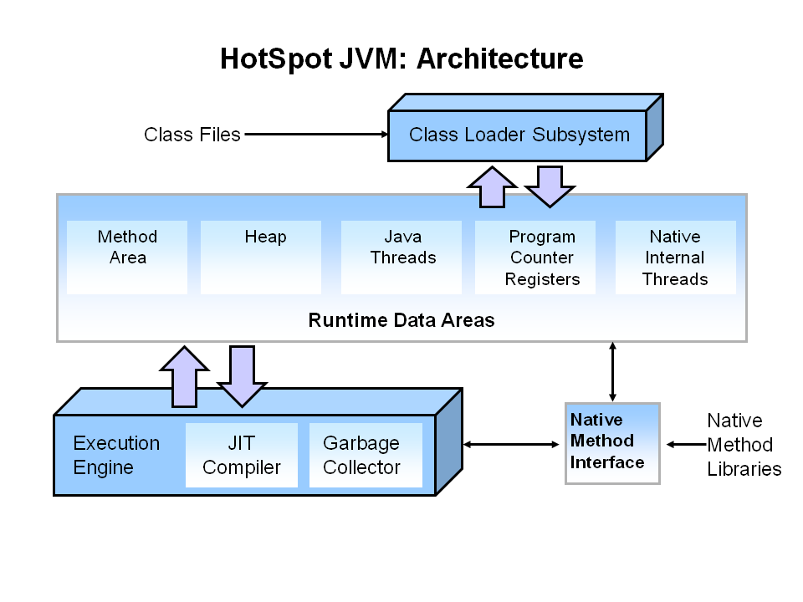
Overview

Slide 48
Memory model

Slide 49
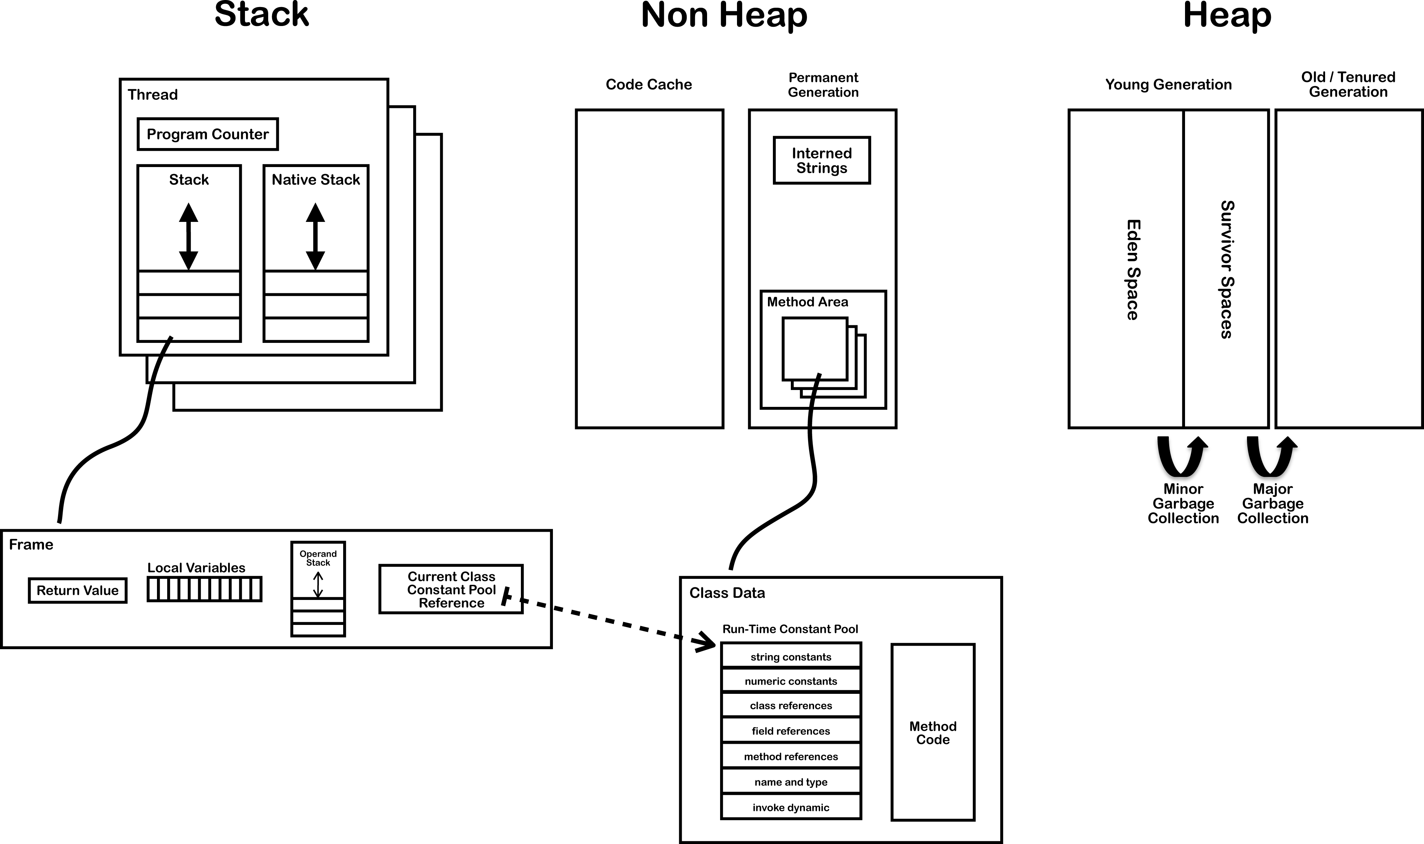
Modelo de memória

Slide 50
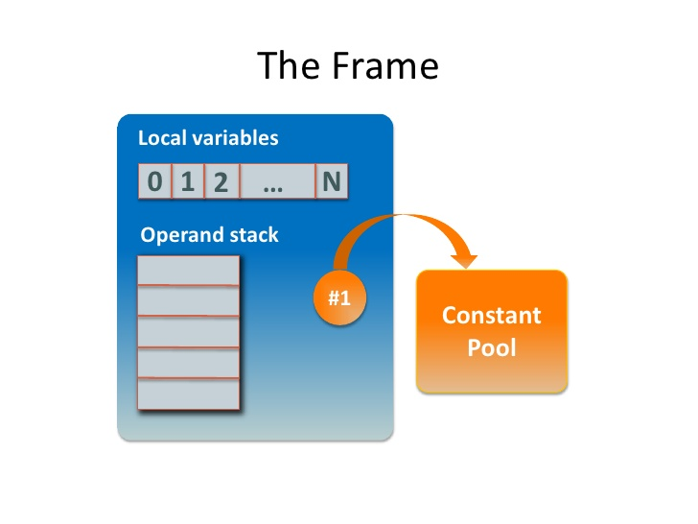

Slide 51
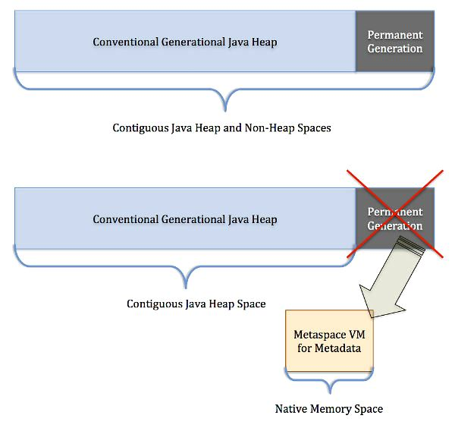

Slide 52
Garbage Collector

Slide 53
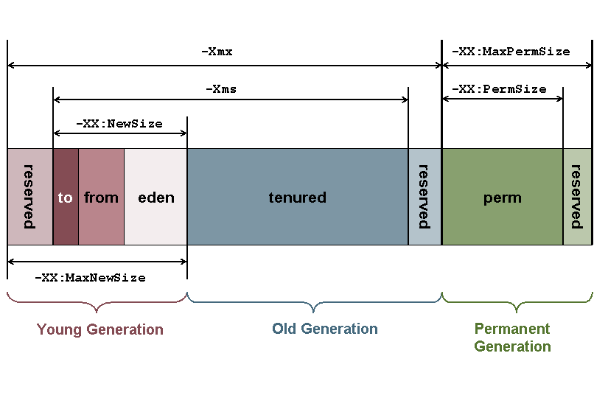
Garbage Collector

Slide 54
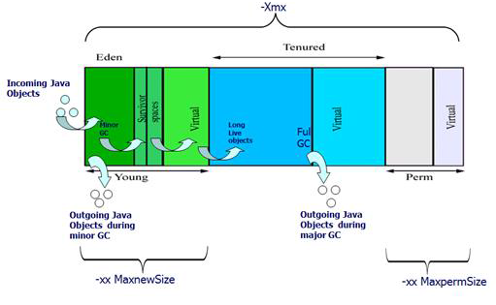

Slide 55
Kinds of GC
-XX:+UseSerialGC
-XX:+UseParallelGC
-XX:+UseConcMarkSweepGC
-XX:+UseG1GC

Slide 56
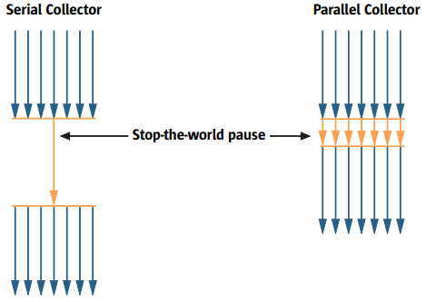

Slide 57
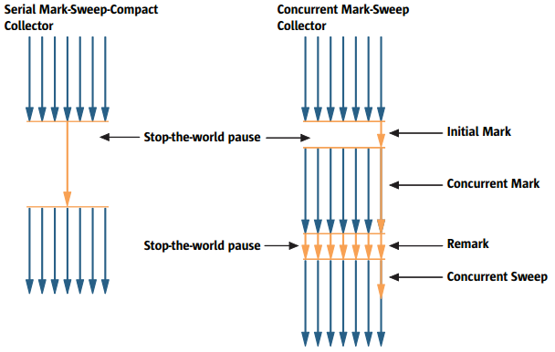

Slide 58
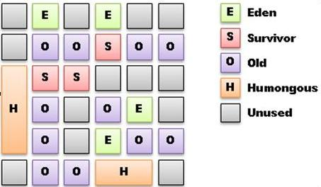
G1

Slide 59
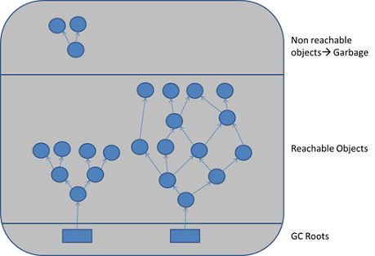
Java threads, jni references, static and local variables

Slide 60
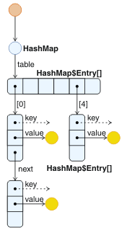

Slide 61
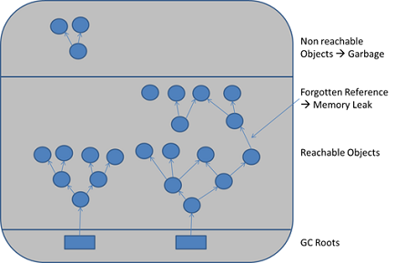
Memory leak

Slide 62
Flags
You need at least: – -XX:+PrintGCTimeStamps
Add -XX:+PrintGCDateStamps if you must know the time
– -XX:+PrintGCDetails
Preferred over -verbosegc as it's more detailed
Also useful: – -Xloggc:<file>
– Rotate GC Log, After Java 1.6_34 (or 1.7_2):
-XX:+UseGCLogFileRotation
-XX:NumberOfGCLogFiles=5
-XX:GCLogFileSize=10M

Slide 63
Classloader

Slide 64
JIT

Slide 65
JIT.pdf
See the JIT.pdf in doc directory

Slide 66
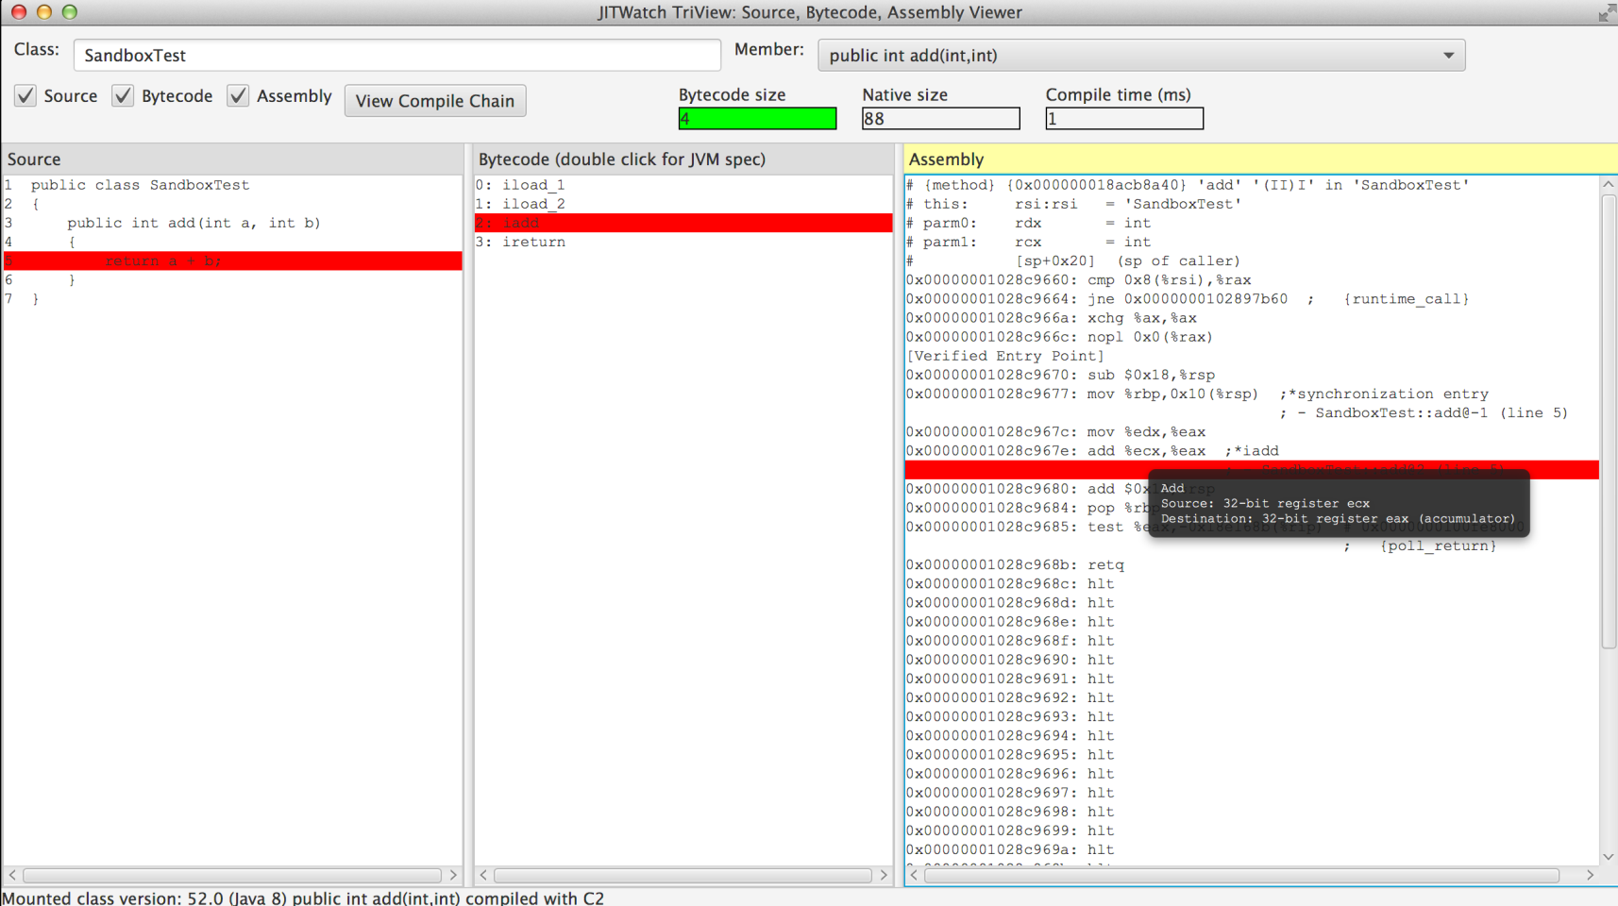
JITWatch

Slide 67
Execution engine

Slide 68
See the JVM_For_Dummies.pdf

Slide 69
The jdk tools

Slide 70
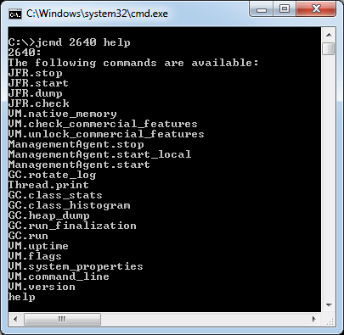
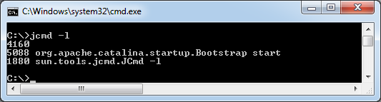
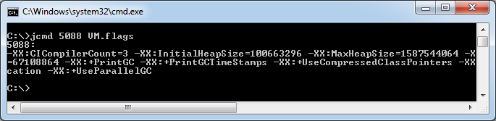
jcmd

Slide 71
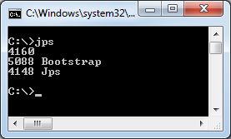
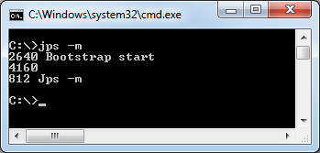
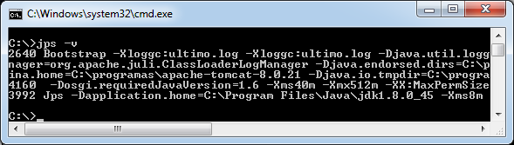
JPS

Slide 72
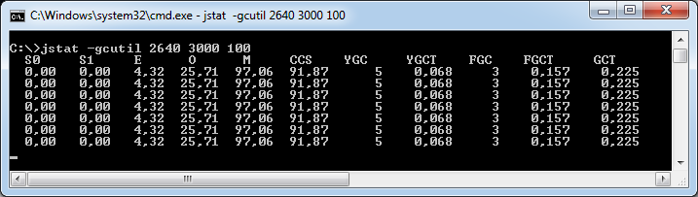
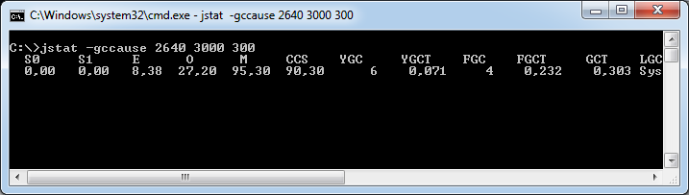
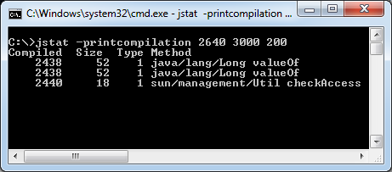
jstat

Slide 73
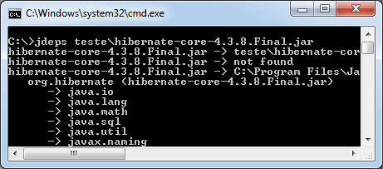
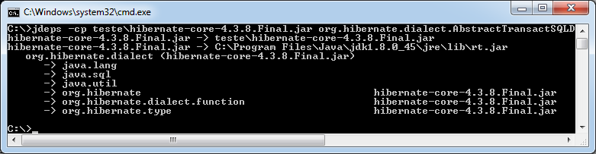
jdeps

Slide 74
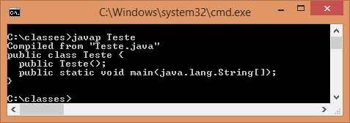
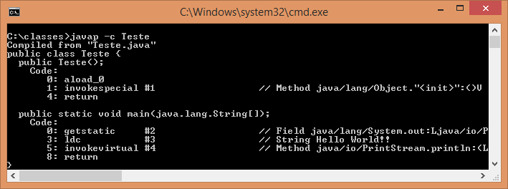
javap

Slide 75
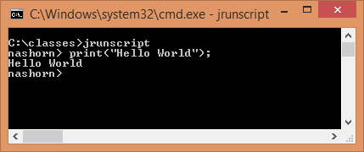
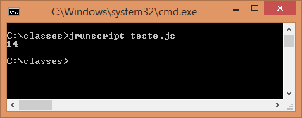
jrunscript

Slide 76
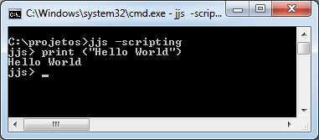
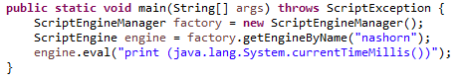
jjs

Slide 77
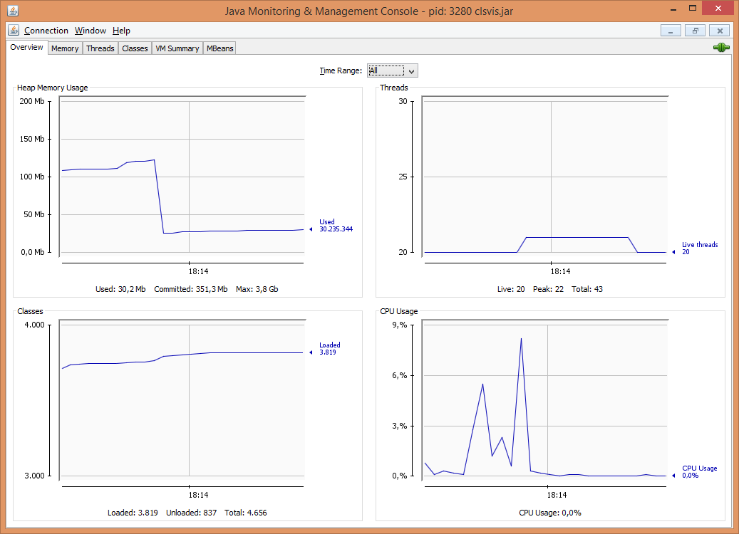
jconsole

Slide 78

jvisualvm

Slide 79
JVM Flags

Slide 81
MAT and GCMV

Slide 83
Using memory

Slide 84
References
Strong
Weak
Soft
Phanton

Slide 85

Weak

Slide 86

Soft

Slide 87

Soft

Slide 88

Phantom

Slide 89

Finalize - Guardian

Slide 90

FileInputStream

Slide 91

Chain of finalazers

Slide 92
Method factory /Flyweight

Slide 93

No instanciable classes
Math
Arrays
Collections

Slide 94

Lazy initialization

Slide 95

Singleton

Slide 96

Singleton enum

Slide 97

Thread local

Slide 98

String

Slide 99
Micro benchmark
JMH

Slide 100
Examples on JMH
https://github.com/apedrina/altaperformance.git
Jmh project

Slide 101
Application Web performance

Slide 103
Agent

Slide 104
Github
Agent project

Slide 105
Aop

Slide 106
github
Aop project

Slide 107
EJB / RMI

Slide 109
Arquitetura
DDD e SOA

Slide 110

Three layers

Slide 111

BoundedContext

Slide 112

Events and jms

Slide 113

Where is the microservices?

Slide 114
Agile manifesto

Slide 115
Scrum

Slide 116
XP

Slide 117
Clean code

